Slide 1


INSURANCE PREMIUM ANALYSIS (EDA AND MACHINE LEARNING)
JYOTHSNA

Slide 2

INSURANCE PREMIUM ANALYSIS
The purpose of the Exploratory Data Analysis , Data Visualization and Machine Learning to use this information to predict charges for the new customers. Our simple dataset contains a few attributes for each person such as Age, Sex, BMI, Children, Smoker, Region and their charges.

Slide 3

age | sex | bmi | children | smoker | region | charges
19 | female | 27.9 | 0 | yes | southwest | 16884.92
18 | male | 33.77 | 1 | no | southeast | 1725.552
28 | male | 33 | 3 | no | southeast | 4449.462
33 | male | 22.705 | 0 | no | northwest | 21984.47
32 | male | 28.88 | 0 | no | northwest | 3866.855
31 | female | 25.74 | 0 | no | southeast | 3756.622
46 | female | 33.44 | 1 | no | southeast | 8240.59
37 | female | 27.74 | 3 | no | northwest | 7281.506
37 | male | 29.83 | 2 | no | northeast | 6406.411
60 | female | 25.84 | 0 | no | northwest | 28923.14
25 | male | 26.22 | 0 | no | northeast | 2721.321
62 | female | 26.29 | 0 | yes | southeast | 27808.73
23 | male | 34.4 | 0 | no | southwest | 1826.843
56 | female | 39.82 | 0 | no | southeast | 11090.72
27 | male | 42.13 | 0 | yes | southeast | 39611.76
19 | male | 24.6 | 1 | no | southwest | 1837.237
52 | female | 30.78 | 1 | no | northeast | 10797.34
23 | male | 23.845 | 0 | no | northeast | 2395.172
56 | male | 40.3 | 0 | no | southwest | 10602.39
30 | male | 35.3 | 0 | yes | southwest | 36837.47
60 | female | 36.005 | 0 | no | northeast | 13228.85
30 | female | 32.4 | 1 | no | southwest | 4149.736
18 | male | 34.1 | 0 | no | southeast | 1137.011
34 | female | 31.92 | 1 | yes | northeast | 37701.88
37 | male | 28.025 | 2 | no | northwest | 6203.902
59 | female | 27.72 | 3 | no | southeast | 14001.13
63 | female | 23.085 | 0 | no | northeast | 14451.84
55 | female | 32.775 | 2 | no | northwest | 12268.63
VIEW OF DATASET

Slide 4

DETAILS OF DATSET
CATEGORICAL VARIABLES
NUMERICAL VARIABLES
NO MISSING VALUES
1338 ROWS AND 7 COLUMNS

Slide 5
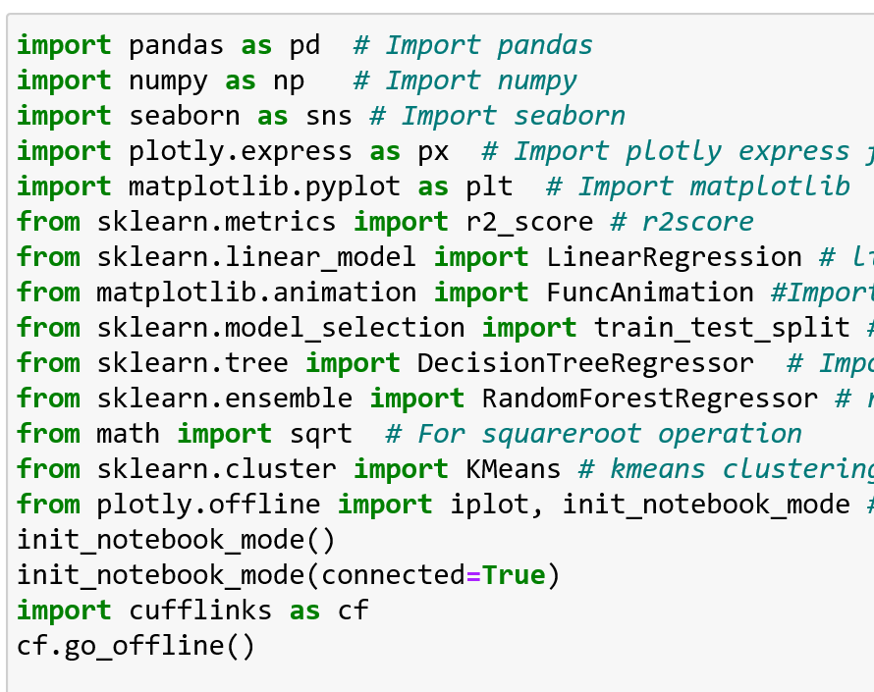
LIBRARIES USED

Slide 6
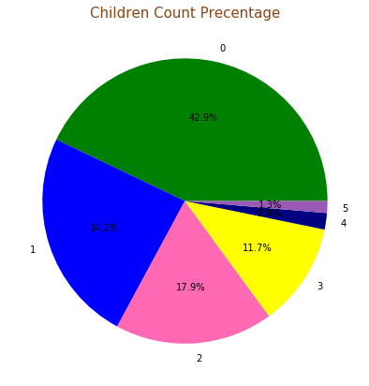
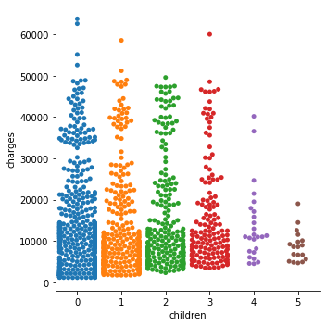
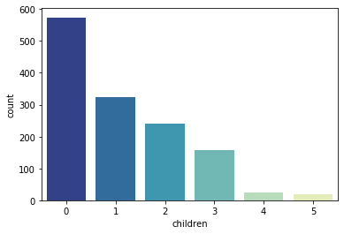
How does children affect Life Insurance Charges ?
The bar plot figure shows that most customers does not have children and very few customers have 4 or 5 children.
The Pie chart shows that 42.9 % of customers does not have children, 24.2% of customers have one child, 17.9 % have two children, 11.7 % have three children ,1.9 % have four children and 1.3 % have five children.
The swarm plot shows that customers who doesn't have any children or 1 child insurance charges are less.

Slide 7
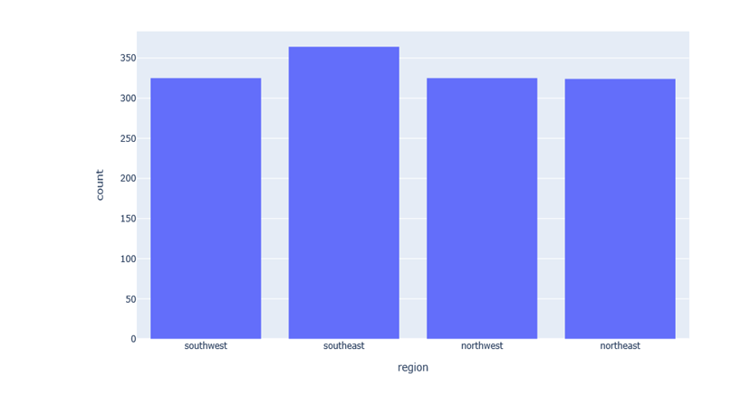
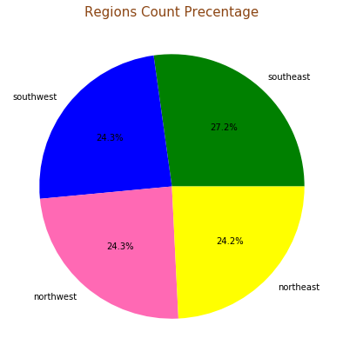
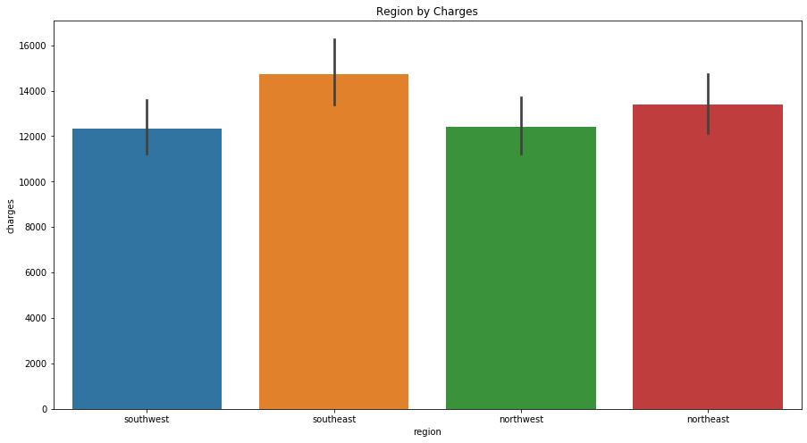
How does Regions affect Life Insurance Charges ?
The first graph shows that the most customers from Southeast and the least number of customer from Northeast.
The second figure shows that 24.3 % customers from southwest, 27.2% customers from southeast, 24.3% customers from northwest and 24.2% customers from northeast.
The third figure show that customers from southeast charges more than other regions and customers charges from southwest charges less than other regions.

Slide 8
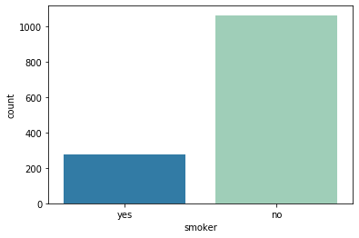
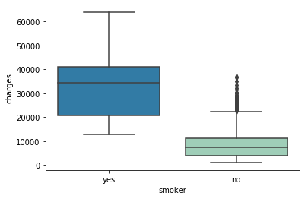
How does smoking affect Life Insurance Charges ?
The first figure above shows that Non-smokers’ customers are more compared to smokers’ customers.
The second figure shows that Insurance charges were high for smokers than non-smokers.

Slide 9
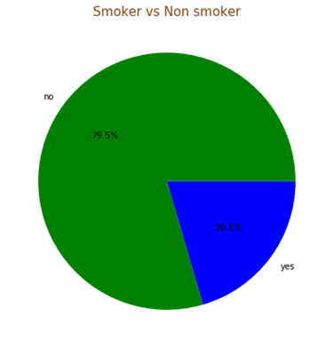
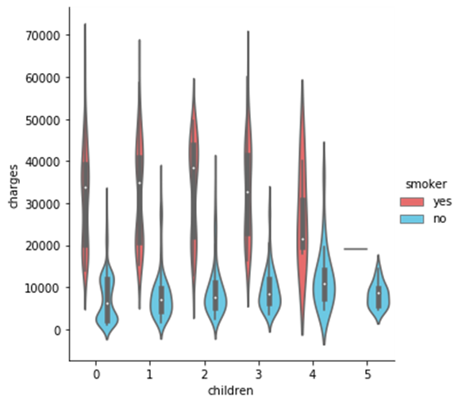
How does smoking affect Life Insurance Charges ?
The first figure shows that 79.5 % of customers are non-smokers and 20.5% of customers are smokers.
The second figure shows that customers with five children and nonsmokers charges are less than other customers .

Slide 10
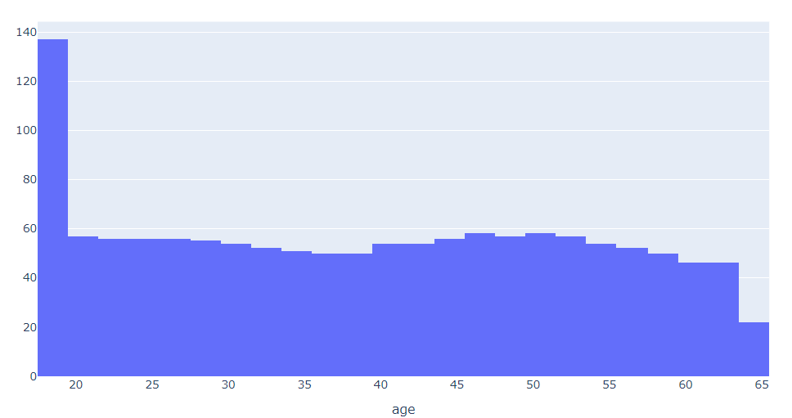
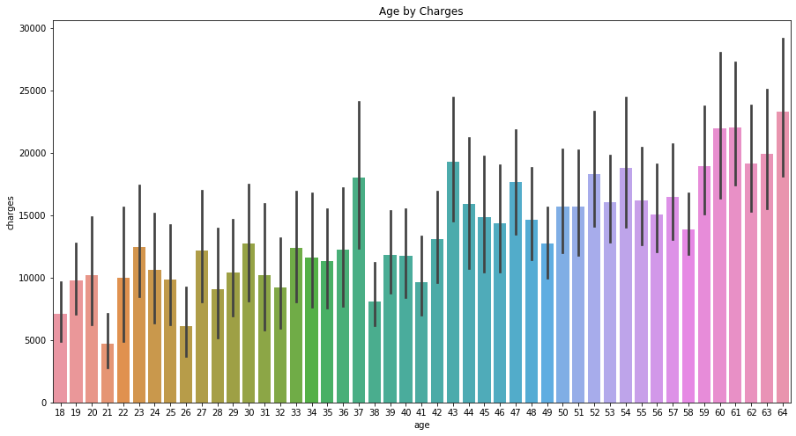
How age affects life insurance charges ?
The first figure shows that ages between 18 and 19 are and age between 64 - 65 are the lowest the highest number of people who having Life Insurance umber of people who having life insurance.
The second figure shows that the charges are high for older customers than younger customers.

Slide 11
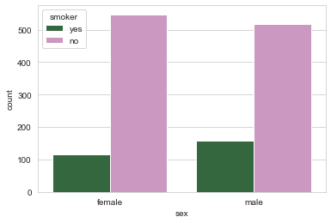
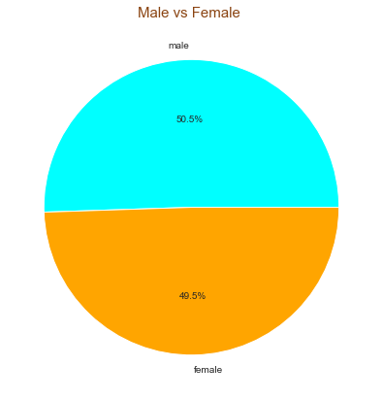
How does gender affect life insurance charges ?
The first figure shows that males who smoke are greater than females.
The second above shows that there are 50.5% of customers are male and 49.5% of customers are female.

Slide 12
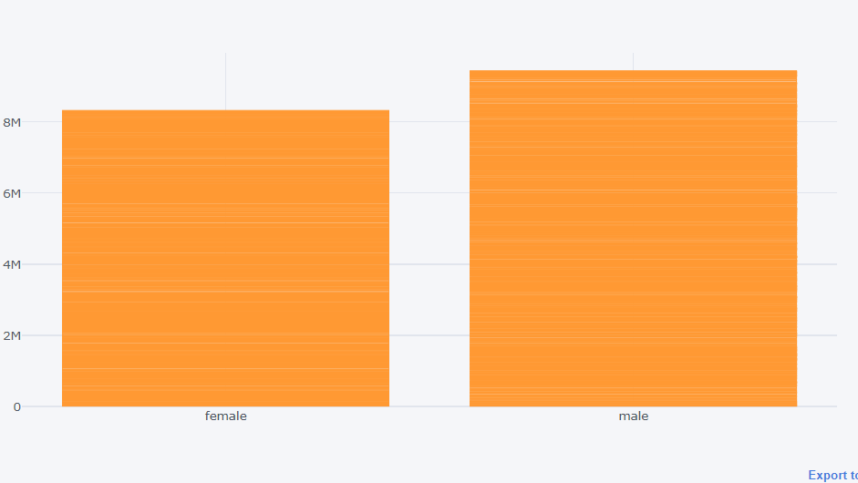
Interactive bar plot of sex vs charges
* The Interactive bar plot above shows that males charges more than female .

Slide 13
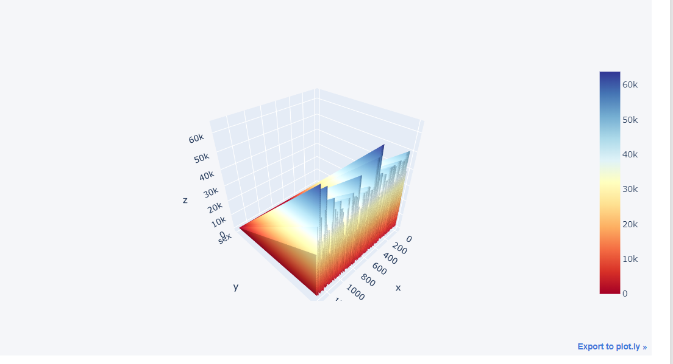
Interactive 3D plot
The interactive 3D plot shows the dark blue is where life insurance charges getting higher and the dark orange is where life insuance cost getting lower by gender.

Slide 14
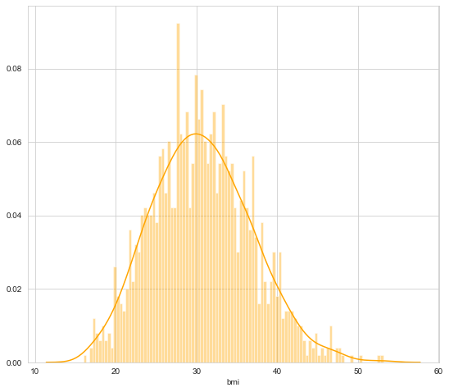
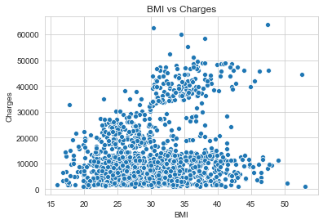
BMI vs. Charges
The histogram shows that there is a peak at BMI of 30. More number of people are in the range of BMI between 25-35.
The scatter plot figure above shows that Insurance charges are high for customers whose BMI is high.

Slide 15
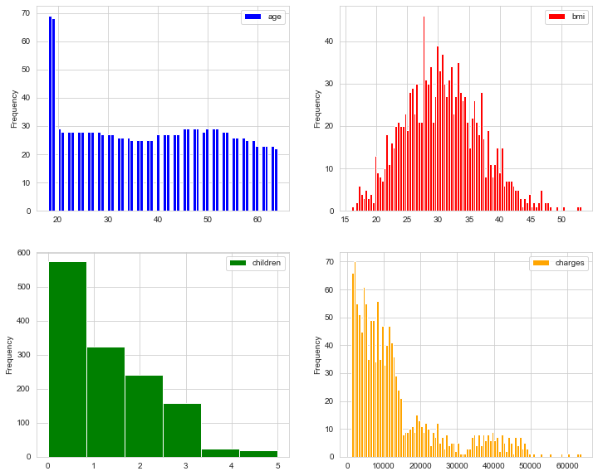
Frequency Histogram for the data variables
Histograms on the right, we get the max percentage of people in each variable range. We can see that that frequency of people are more in age group ranging from 18-20. Majority of people have body mass index between 30-35. And majority of people have no children who have subscribed for Insurance policy and the max Insurance charges charged were in the range is from 1000-15000 .

Slide 16
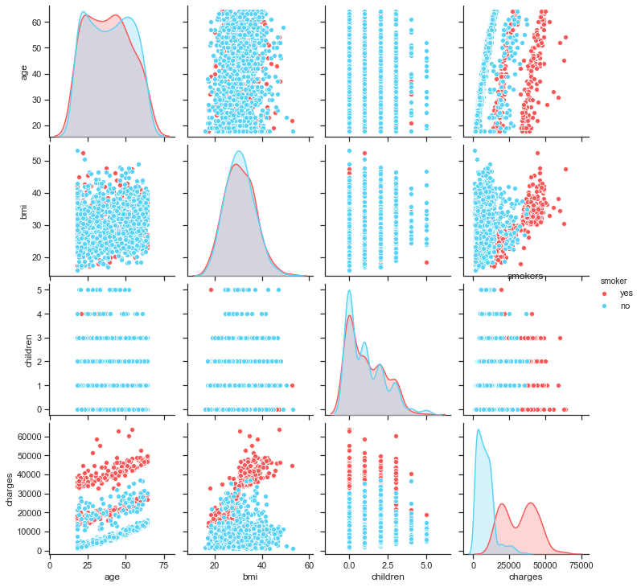
The relationship between smoker and other variables
The pair plot shows the relationship between variables and smoker . The red represents smoker and the blue represents nonsmokers.

Slide 17
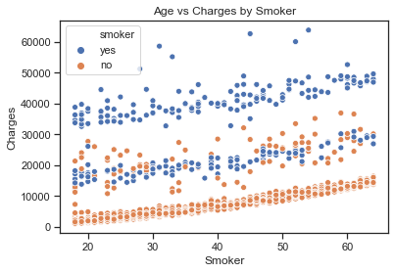
Age vs Charges by Smoker
The scatterplot shows the relationship of Age vs Expenses by smoker. There is a correlation between smokers and charges, age and charges. As the age hikes up and smoking ratio increases the insurance premium charges hiked up.

Slide 18
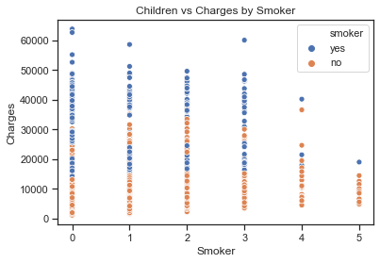
Children vs Charges by Smoker
Scatterplot shows that customers who smoke and do not have children charged more than other. Although customers who have smoke and have five children did not charge like other smokers.

Slide 19
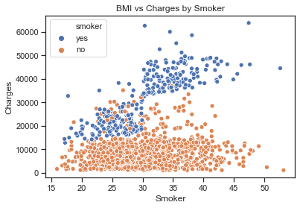
BMI vs Charges by Smoker
The scatterplot shows that nonsmokers with high BMI charges less that customers who are smokers with high BMI.

Slide 20
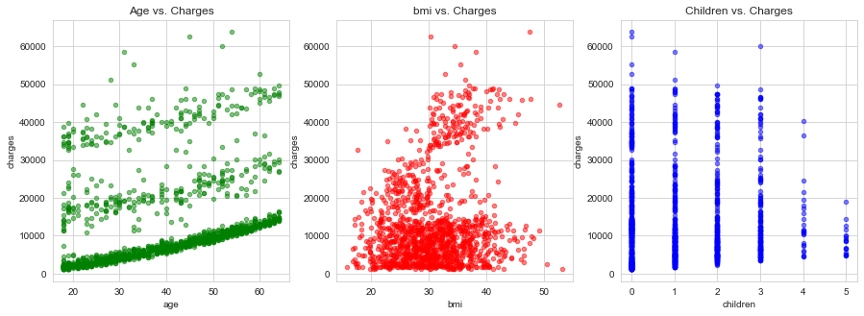
Checking correlation between all variables with Charges
By the above scatter plot matrix we can see that Insurance premium charges raised as the age increases. As Insurance charges was charged to people between
age group 50-60 and above. As the BMI increases insurance premium charges increased. As insurance charges are between 40-50 BMI.
Max insurance premium charges are for the people who don't have any kid
The insurance charges were minimum for people who have 4 or 5 children.

Slide 21
MACHINE LEARNING MODELS
R2 score for multiple linear regression is 0.79
R2 score for Random Forest regression is 0.86
R2 score for decision tree regression is 0.726
Hence Random Forest regression is best model.

Slide 22
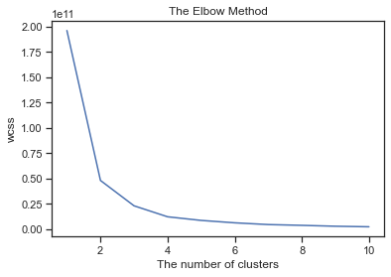
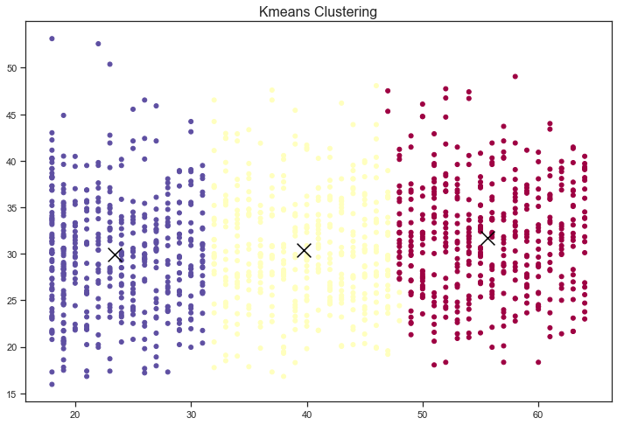
K-means Clustering
The elbow method is a technique to choose the greatest number of clusters. The graph below shows that there are 3 clusters in the data set.

Slide 23
CONCLUSION
Insurance charges were high for smokers than non-smokers.
Insurance charges were high for customers who don't have children and less for who have a greater number of children.
Insurance charges trends up as the age increases.
More customers are from southeast region and less in northeast region.
Insurance charges are high for customers whose BMI is high.
Majority of customers have BMI in the range between 30-35.
More customers are in the age group ranging from 18-20.
Female nonsmokers are high when compared to male nonsmokers.
Nonsmokers are more compared to smokers.
Males are 1% more in number compared to females.
Majority of customers doesn't have children and very few customers have 4 or 5 children.
There is a positive correlation with all independent variables and dependent variable.
There is a negative correlation with the Independent variable children and Insurance charges as the children increases insurance charges decreases.

Slide 24


